Slide 1
Data analysis & Empirical Model of dielectric constant measurements
Yutong Zhao
Jan 22nd ,2018

Slide 2
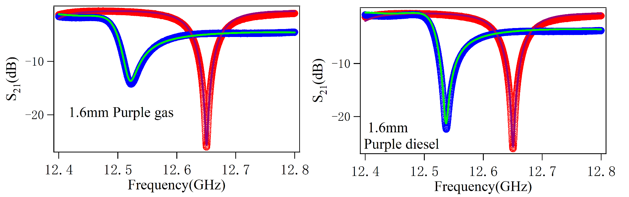
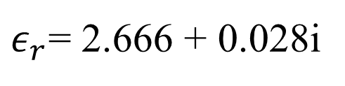
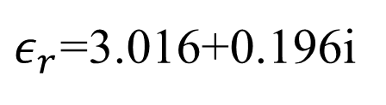
Determined gasoline and diesel
$ε_{r}$=3.016+0.196i
$ε_{r}$= 2.666 + 0.028i
Gasoline absorb microwave at dry!
Notes:
We found that gas have a significate large imaginary part epsilon. Also that of diesel is not negligible.

Slide 3
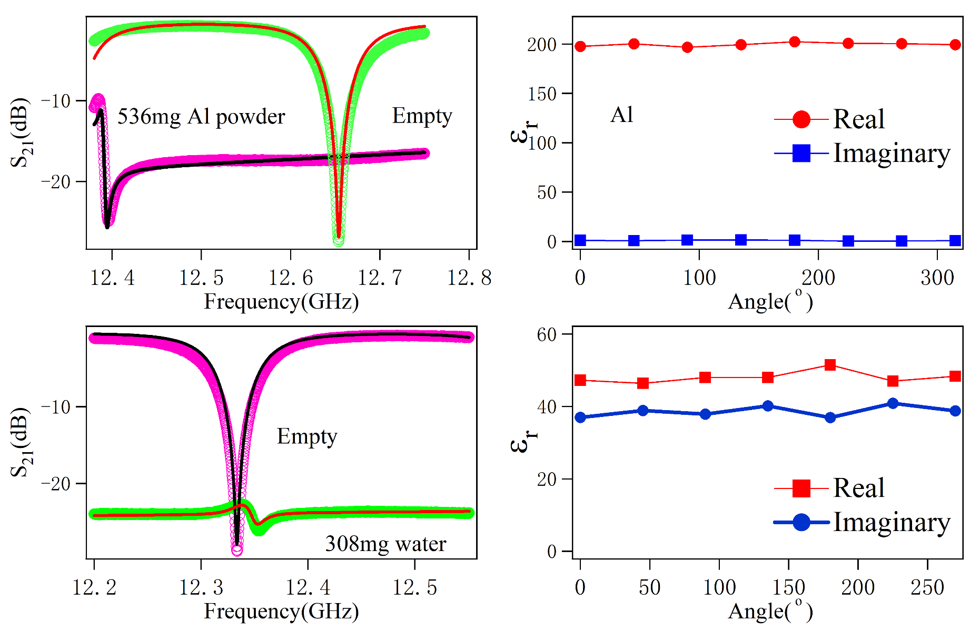
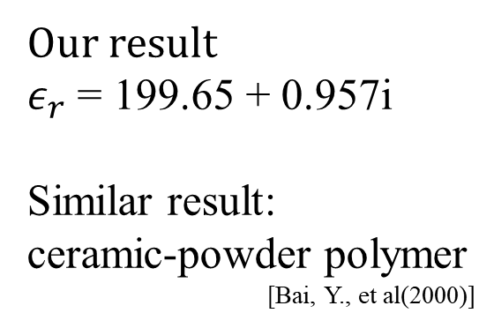
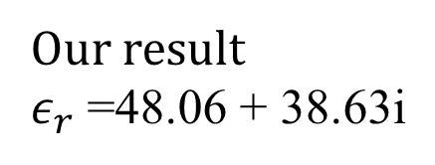
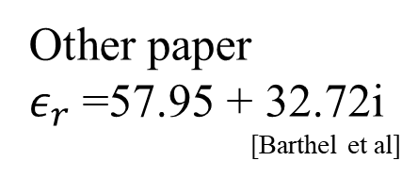
Problems of Al and water
Our result
$ε_{r}$= 199.65 + 0.957i
Similar result:
ceramic-powder polymer
[Bai, Y., et al(2000)]
Our result
$ε_{r}$=48.06 + 38.63i
H mode
Other paper
$ε_{r}$=57.95 + 32.72i
[Barthel et al]
Notes:
These results are doubtable because the resonate peaks are so close to H mdoe , we are planning doing these measurement in a different method.

Slide 4
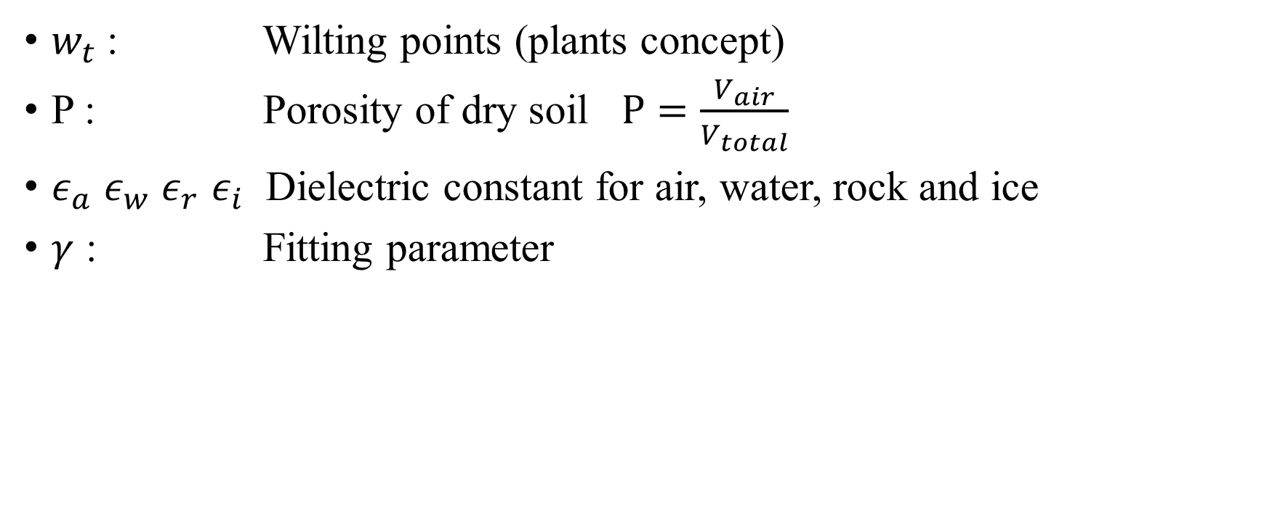
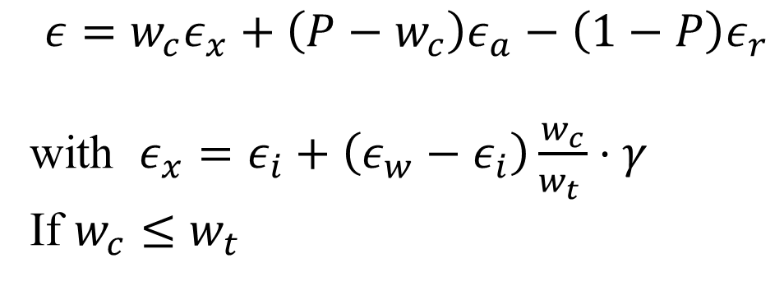
Empirical Model for Soils
Wang, J. R., & Schmugge, T. J. (1980).
IEEE Transactions on Geoscience and Remote Sensing,
(4), 288-295.
$w_{t}$: Wilting points (plants concept)
P : Porosity of dry soil $P=\frac{V_{air}}{V_{total}}$
$ε_{a}$ $ε_{w}$ $ε_{r}$ $ε_{i}$ Dielectric constant for air, water, rock and ice
$γ$ : Fitting parameter
$$ε=w_{c}ε_{x}+\left(P−w_{c}\right)ε_{a}−\left(1−P\right)ε_{r}$$
with $ε_{x}=ε_{i}+\left(ε_{w}−ε_{i}\right)\frac{w_{c}}{w_{t }}⋅γ$
If $w_{c}≤w_{t}$
Notes:
I have found a dielectric model for different soils, it is an empirical model with a lot of parameters.

Slide 5
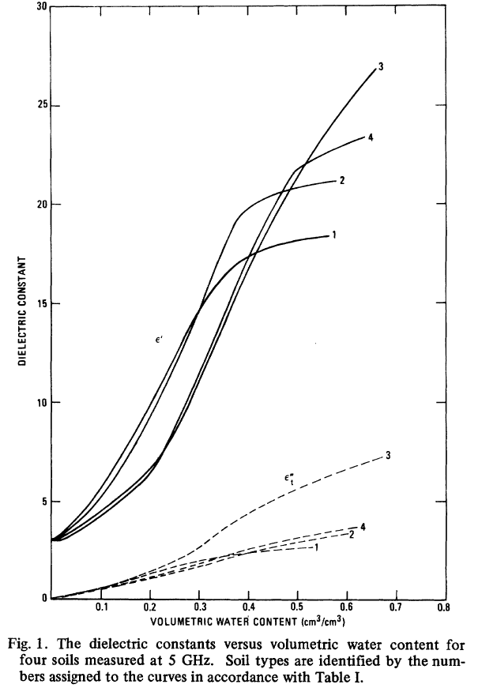
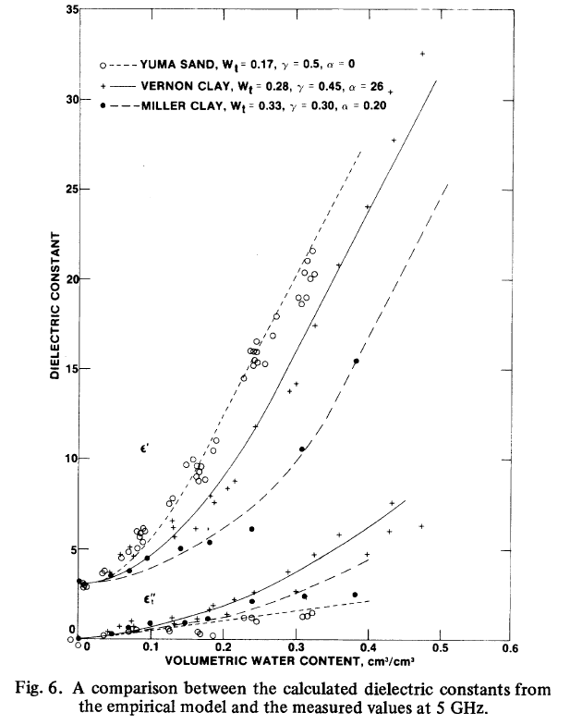
Real part
Imaginary part
Different soil at 5 GHz
Data and model fit at 5 GHz
Notes:
Based on their paper, their model agrees with measurement quite well.

Slide 6


Simplified model
No air , P = 0 and no ice involved
Replace $ε_{r}$ (rock) with $ε_{sample}$(dry)
Consider conductivity loss $ε_{r}′′=ε′′+α⋅w_{c}^{2}$
$$ε=ε_{s}+aε_{w}+bε_{w}^{2}$$
$$ε^{∗}=Re\left(ε\right)+[Im\left(ε\right)+α⋅w_{c}^{2}]∗i$$
Next step fitting

Slide 7
Fitting results at $α$ = 0
Sugar
KClO₃
NaCl
NH₄NO₃
NaNO₃
KNO₃

Slide 8
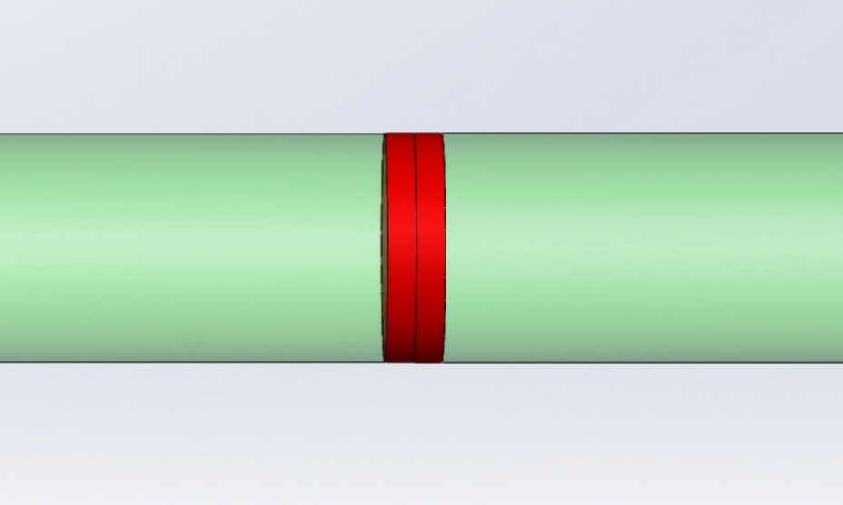
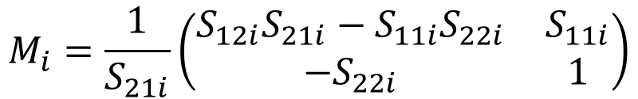




Method for water & Al powder
Transmission /Reflection(T/R) method
Air
Air
Port 1
Port 2
Sample
$$M_{i}=\frac{1}{S_{21i}}\left(\begin{matrix}S_{12i}S_{21i}−S_{11i}S_{22i} & S_{11i} \\ −S_{22i} & 1\end{matrix}\right)$$
Transmission Matrices
$$γ_{i}=γ_{i}(ε_{i},μ_{i})$$
$$T_{i}= \left(\begin{matrix}e^{−γ_{i}d} & 0 \\ 0 & e^{γ_{i}d}\end{matrix}\right)$$
$$M_{i}=x⋅T_{refi}⋅T_{i}⋅T_{refi}^{−1}⋅y$$
$$T_{refi}= \left(\begin{matrix}\frac{1}{1−Γ_{i}} & \frac{Γ_{i}}{1−Γ_{i}} \\ \frac{Γ_{i}}{1−Γ_{i}} & \frac{1}{1−Γ_{i}}\end{matrix}\right)$$

Slide 9
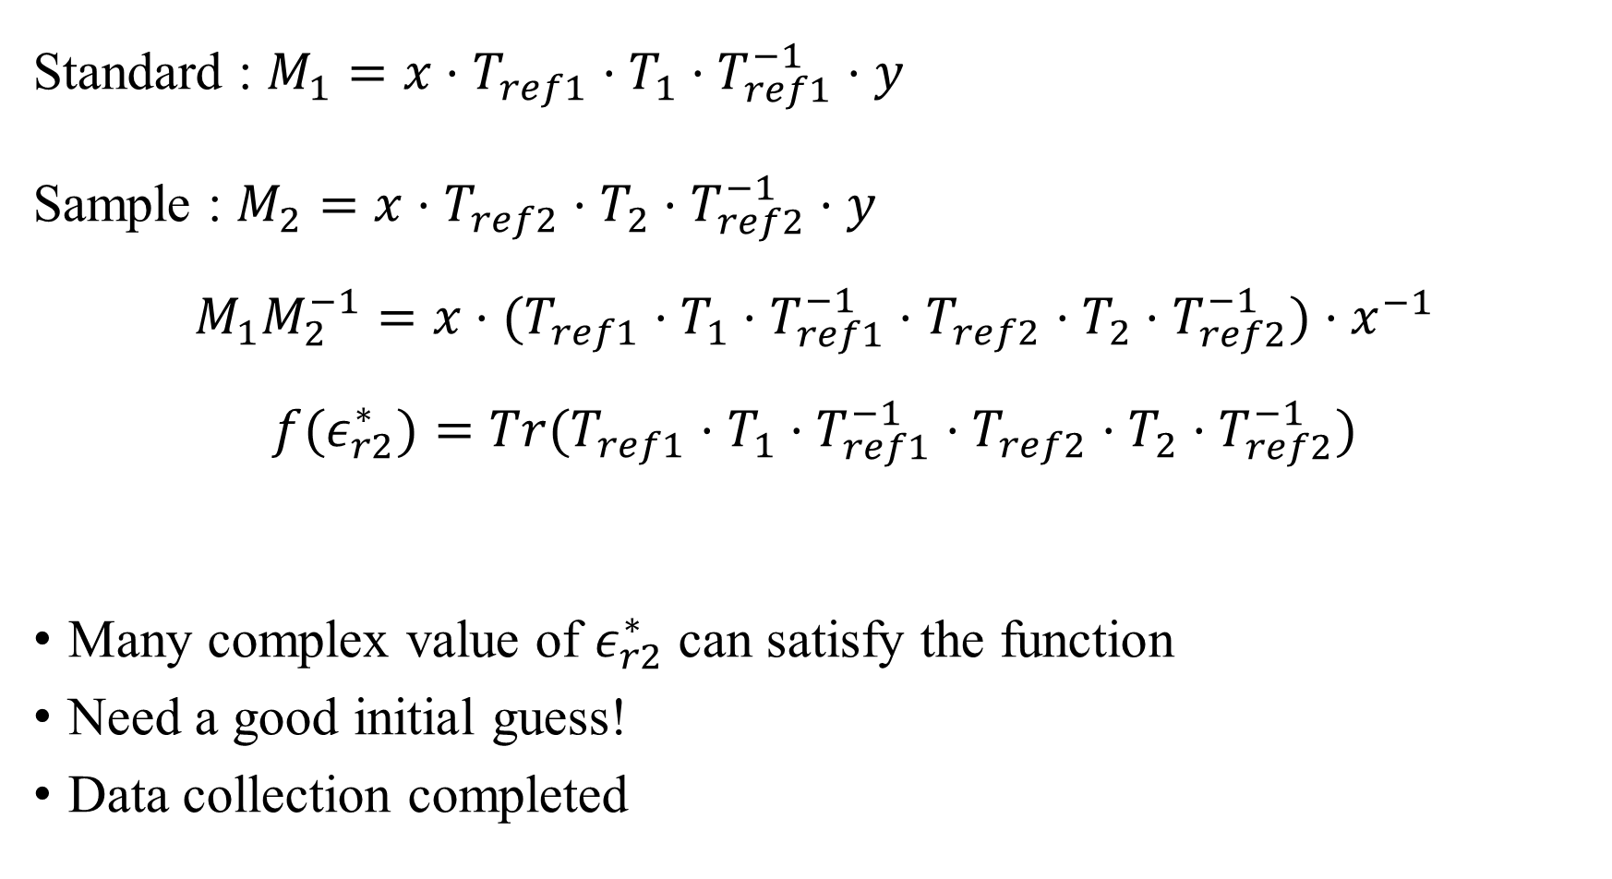
Eliminate systematic error x & y
Standard : $M_{1}=x⋅T_{ref1}⋅T_{1}⋅T_{ref1}^{−1}⋅y$
Sample : $M_{2}=x⋅T_{ref2}⋅T_{2}⋅T_{ref2}^{−1}⋅y$
$$M_{1}M_{2}^{−1}=x⋅(T_{ref1}⋅T_{1}⋅T_{ref1}^{−1}⋅T_{ref2}⋅T_{2}⋅T_{ref2}^{−1})⋅x^{−1}$$
$$f(ε_{r2}^{∗})=Tr(T_{ref1}⋅T_{1}⋅T_{ref1}^{−1}⋅T_{ref2}⋅T_{2}⋅T_{ref2}^{−1})$$
Many complex value of $ε_{r2}^{∗}$ can satisfy the function
Need a good initial guess!
Data collection completed

Slide 10

Next step
Analysis data by setting $α$ ≠ 0 in empirical model for water content.
Build a Matlab code calculate the $ε_{r}$ using T/R method.

